Slide 1
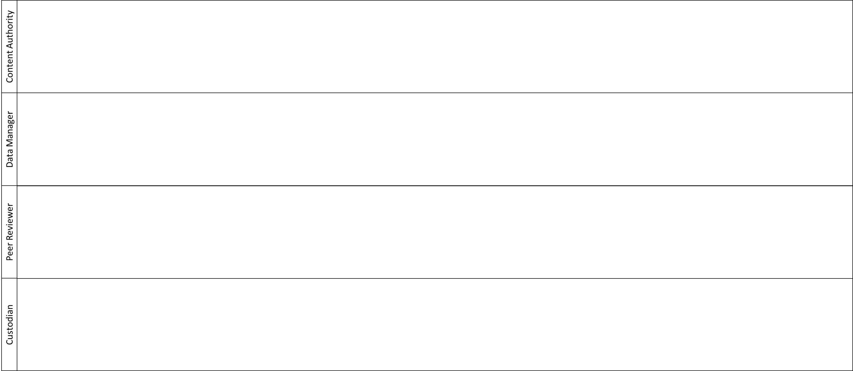
Search Existing Vocabs
Yes
Edit Vocabulary
START
Found
Submit Vocabulary
[dev- to review-]
Extract GSQ Lists
Create Vocabulary
No
SKOS Optimisation
No
Publish to
VocPrez Test
Valid
Yes
Publish
END
Minor
fixes
Technical
Review
Pull Request
[review- to master-]
Content
Review
Endorsed
No
Yes
Business
Review
Approved
No

Slide 2
Search Existing Vocabularies
Content Authority
Check for existing vocabularies and standards that may exist for the subject. These may be formalised SKOS style vocabularies, or simply existing lists of terms accepted in the field of knowledge that can be converted to a vocabulary.
Search the following for structured vocabularies
Research Vocabularies Australia https://vocabs.ands.org.au/
Geoscience Australia http://ldweb.ga.gov.au/def/voc/ga/
ISO 19115 https://geo-ide.noaa.gov/wiki/index.php?title=ISO_19115_and_19115-2_CodeList_Dictionaries
Basel Register https://bartoc.org/
British Geological Survey https://www.bgs.ac.uk/data/vocabularies/home.cfm
Google search your subject of interest terms such as vocabulary, hierarchy, glossary, dictionary, code list, classification, categories.
Back to Top ↑

Slide 3
Extract GSQ List
Content Authority
Check existing code lists used by GSQ.
These may come from any of the GSQ legacy systems such as MERLIN and GEM, or associated DNRME divisions such as Spatial and Graphic Services.
Be aware that the goal of this process is to create new vocabularies that capture the hierarchies and relationships that a flat list cannot articulate. It is an opportunity to eliminate the errors of the past such as composite terms (Open Cut – Proposed), ambiguous terms (Mixed Unit Type), and misapplied terms (Lava).
Highlight what needs to be added, deleted, or changed in the extracted list(s).
Terms that should not be used in the future, but still have value in describing past entries can still be maintained as hidden terms in the final product.
Back to Top ↑

Slide 4
Create or Edit Vocabulary
Content Authority
Vocabularies should be based on existing standards where possible. They may derive from government organisations, academic bodies, collaborative organisations, or industry technical specifications. The order of preference is:
International Standard
National Standard
Queensland Standard
Custom GSQ vocabulary
Existing standards may be edited to suit GSQ needs or a GSQ vocabulary may be created and mapped to existing standards if required.
It is recommended that a hierarchy or list should be informally sketched out or created in a spreadsheet to understand structure and content, prior to formal construction.
Once mapped into preliminary form, construction of a structured vocabulary can be done using one of the custom tools.
Using Excel Vocabulary Builder
Using VocBench Vocabulary Builder
Back to Top ↑

Slide 5
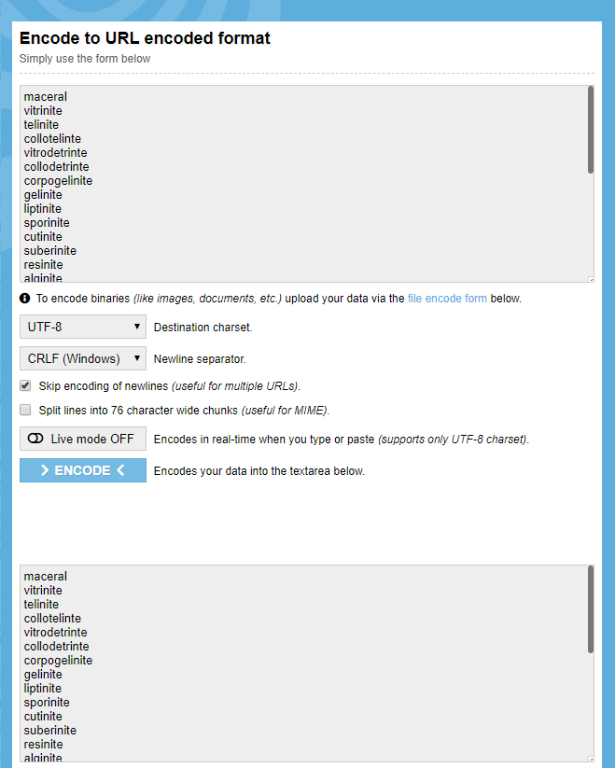
Excel Vocabulary Builder – Hierarchy
Content Authority
Order | Rank | Name | IS_COLLECTION | No Wildcard
1 | 0 | Maceral |  | maceral
2 | 1 | Vitrinite |  | vitrinite
3 | 2 | Telinite |  | telinite
4 | 2 | Collotelinte |  | collotelinte
5 | 2 | Vitrodetrinte |  | vitrodetrinte
6 | 2 | Collodetrinte |  | collodetrinte
7 | 2 | Corpogelinite |  | corpogelinite
8 | 2 | Gelinite |  | gelinite
9 | 1 | Liptinite |  | liptinite
10 | 2 | Sporinite |  | sporinite
11 | 2 | Cutinite |  | cutinite
12 | 2 | Suberinite |  | suberinite
13 | 2 | Resinite |  | resinite
14 | 2 | Alginite |  | alginite
15 | 3 | Telalgintie |  | telalgintie
16 | 3 | Lamalgintie |  | lamalgintie
17 | 2 | Bituminite |  | bituminite
18 | 2 | Exsudatinite |  | exsudatinite
19 | 2 | Fluorinite |  | fluorinite
20 | 2 | Liptodetrinite |  | liptodetrinite
21 | 2 | Chlorophyllinite |  | chlorophyllinite
22 | 1 | Inertinite |  | inertinite
23 | 2 | Fusinite |  | fusinite
24 | 2 | Semifusinite |  | semifusinite
25 | 2 | Secretinite |  | secretinite
26 | 2 | Funginite |  | funginite
27 | 2 | Macrinite |  | macrinite
28 | 2 | Inertodetrinite |  | inertodetrinite
29 | 2 | Micrinite |  | micrinite
Coded Name (encoded results from No Wildcard copy to www.urlencoder.org)
maceral
vitrinite
telinite
collotelinte
vitrodetrinte
collodetrinte
corpogelinite
gelinite
liptinite
sporinite
cutinite
suberinite
resinite
alginite
telalgintie
lamalgintie
bituminite
exsudatinite
fluorinite
liptodetrinite
chlorophyllinite
inertinite
fusinite
semifusinite
secretinite
funginite
macrinite
inertodetrinite
micrinite
Create hierarchy of ranked classes and sub-classes, where rank 0 are the top classes, all rank 1 classes are a types of rank 0, all rank 2 are types of the preceding rank 1, and so on.
Open urlencoder.org
Copy ‘No Wildcard’ column into input
Ensure encoder settings are as above
> ENCODE <
Copy results into ‘Coded Name’ column

Slide 6
Excel Vocabulary Builder – Hierarchy Check
Content Authority
Use the Hierarchy Chart tab to check that the result matches the conceptual model and any relevant classification scheme
Where the upper classifications are not relevant final selections (e.g. Petroleum Report is a non-selectable parent class of Well Completion Report, or Seismic Survey Report), flag the parent class with Y in the ‘Is Collection’ column.
NOTE: The chart to the left is technically incorrect. The vocabulary name should be the subject e.g. Macerals. Your level zero concepts should be the first layer beneath the overarching subject e.g. the first division of the vocabulary with the subject Macerals should be the level 0 classification between vitrinite, liptinite, and inertinite.

Slide 7
Excel Vocabulary Builder – Details
Content Authority
Enter Details
Coded Names | prefLabel | exactMatch | altLabel | Notation | Definition( recommended to be <500 characters)
maceral | Maceral |  |  |  | A maceral is a component, organic in origin, of coal or oil shale. The term 'maceral' in reference to coal is analogous to the use of the term 'mineral' in reference to igneous or metamorphic rocks.
vitrinite | Vitrinite |  |  | VIT | Vitrinite is shiny, glass-like material that is considered to be composed of cellular plant material such as roots, bark, plant stems and tree trunks. Vitrinite macerals when observed under the microscope show a boxlike, cellular structure, often with oblong voids and cavities which are likely the remains of plant stems.
telinite | Telinite |  |  |  | A maceral originating from plant cell walls, that retains visible structure.
collotelinte | Collotelinte |  |  |  | A maceral originating from plant cell walls, that is gelified and structureless.
vitrodetrinte | Vitrodetrinte |  |  |  | A maceral originating from small particles of plant attritus (worn-down particles of plant humus).
collodetrinte | Collodetrinte |  |  |  | A maceral originating from peat groundmass, with a mottled appearance.
corpogelinite | Corpogelinite |  |  |  | A maceral originating from primary and secondary cell infillings from humic gels.
gelinite | Gelinite |  |  |  | A maceral originating from humic matter in crack fillings, with an amorphous structure.
liptinite | Liptinite |  | "exinite"@en; | LIP | Liptinite macerals are considered to be produced from decayed leaf matter, spores, pollen and algal matter. Resins and plant waxes can also be part of liptinite macerals. Liptinite macerals tend to retain their original plant form, i.e., they resemble plant fossils.
resinite | Resinite | http://linked.data.gov.au/def/minerals/amber | "amber"@en; |  | A maceral originating from plant resins, balsams, latexes, fats, and waxes.
Copy Coded_Name column from Hierarchy tab here and remove duplicates. | Will Auto-Populate. | Insert any links to another source vocabulary where the term is an exact match to one used elsewhere. | Insert any alternate terms in the format “term”@en; . | Any relevant notations or codes. | Provide a short, unambiguous definition that clearly distinguishes each term from other terms within the vocabulary.

Slide 8
Excel Vocabulary Builder – SKOS Optimisation
Content Authority
Enter Details
Where a matching vocabulary has been used, enter the relevant http link and a prefix (<8 characters length) that does not conflict with the other listed prefixes The shorter the prefix the better.
e.g. change the green text below.
@prefix abc: <http://vocab.example.org/alphabet/> .
link to URL prefix for this vocabulary | @prefix ssm: <http://linked.data.gov.au/def/seismic-sampling-method/> .
link to vocabulary for exact matches (delete cell contents if no exact match vocab used) | @prefix ex: <http://example.eg.org/vocab/example/> .
VOCABULARY NAME | @prefix dc: <http://purl.org/dc/elements/1.1/> .
Seismic Sampling Method | @prefix dct: <http://purl.org/dc/terms/> .
VOCABULARY PREFIX | @prefix owl: <http://www.w3.org/2002/07/owl#> .
ssm | @prefix rdf: <http://www.w3.org/1999/02/22-rdf-syntax-ns#> .
VOCABULARY DEFINITION | @prefix rdfs: <http://www.w3.org/2000/01/rdf-schema#> .
The classification of tools used as an energy source that generate a seismic signal for use in seismic survey acquisition. | @prefix skos: <http://www.w3.org/2004/02/skos/core#> .
 | @prefix xsd: <http://www.w3.org/2001/XMLSchema#> .
SOURCE NOTES:
Developed by the Geological Survey of Queensland. | <http://linked.data.gov.au/def/seismic-sampling-method> a owl:Ontology .
 | ssm:conceptScheme a skos:ConceptScheme ;
COPY AND PASTE-AS-VALUE FOR FIRST ITERATION OF THIS VOCABULARY -> | dct:created "2019-10-03T13:46:16+10:00"^^xsd:dateTime ;
 | dct:modified "2019-10-03T13:46:16+10:00"^^xsd:dateTime ;
TIME ZONE | dct:source "Developed by the Geological Survey of Queensland." ;
+10:00 | skos:definition "The classification of tools used as an energy source that generate a seismic signal for use in seismic survey acquisition."@en ;
 | dct:creator "Geological Survey of Queensland" ;
 | skos:prefLabel "Seismic Sampling Method"@en .
Enter a vocabulary name that reflects the vocabulary content
Use only plain English words
If the vocabulary is about GSQ specific concepts, then the name must start with “GSQ” e.g. GSQ Dataset Themes
If the vocabulary is about universal concepts, do not prefix with “GSQ” e.g. Earth Science Data Category
Add a short abbreviation for the vocabulary below
Use plain English to describe the content of the vocabulary..
Use plain English to describe the source material and data provenance used to construct the vocabulary and define its hierarchies.
For the first creation of the vocabulary copy this cell and paste-as-value back into this cell to set a fixed creation date.
Change time zone if applicable.
Back to Top ↑

Slide 9
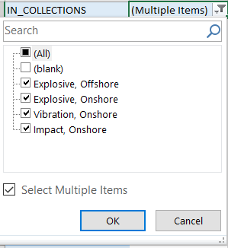
Excel Vocabulary Builder – SKOS Pivot
Content Authority
IN_COLLECTIONS | (Multiple Items) | ←REFRESH HERE
Row Labels | ←REFRESH HERE | In Collections | 1 | 2 | 3 | 4 | 5 | 6 | 7 | 8 | 9 | 10
air-gun | Explosive, Offshore | 2 | Explosive | Offshore
boomer | Explosive, Offshore | 2 | Explosive | Offshore
dynamite | Explosive, Onshore | 2 | Explosive | Onshore
firearm | Explosive, Onshore | 2 | Explosive | Onshore
plasma-sound-source | Explosive, Offshore | 2 | Explosive | Offshore
water-gun | Explosive, Offshore | 2 | Explosive | Offshore
noise-source | Vibration, Onshore | 2 | Vibration | Onshore
vibroseis | Vibration, Onshore | 2 | Vibration | Onshore
accelerated-weight-drop | Impact, Onshore | 2 | Impact | Onshore
hammer | Impact, Onshore | 2 | Impact | Onshore
hydraulic-oil-impactor | Impact, Onshore | 2 | Impact | Onshore
wacker | Impact, Onshore | 2 | Impact | Onshore
weight-drop | Impact, Onshore | 2 | Impact | Onshore
Grand Total
Refresh IN_COLLECTIONS
Refresh Row Labels
In IN_COLLECTIONS and Row Labels filter drop downs, ensure all items are selected except for (blank)
Select collections columns 1-10
Drag formula down as needed to cover full vocabulary list
Back to Top ↑

Slide 10
Excel Vocabulary Builder – SKOS Collections
Content Authority
SKOS RESULT | ssm:impact a skos:Collection ; skos:prefLabel "Impact"@en ; skos:definition "A force is used to contact a mass, or striker, with the ground surface to generate a seismic pulse."@en ; skos:member ssm:accelerated-weight-drop, ssm:hammer, ssm:hydraulic-oil-impactor, ssm:wacker, ssm:weight-drop . | ssm:vibration a skos:Collection ; skos:prefLabel "Vibration"@en ; skos:definition "A mass is held in contact with the ground and oscillated to put a range of frequencies into the earth."@en ; skos:member ssm:noise-source, ssm:vibroseis . | ssm:explosive a skos:Collection ; skos:prefLabel "Explosive"@en ; skos:definition "An explosive, or explosive material, is a reactive substance that contains a great amount of potential energy that can produce an explosion if released suddenly, usually accompanied by the production of light, heat, sound, and pressure. "@en ; skos:member ssm:air-gun, ssm:boomer, ssm:dynamite, ssm:firearm, ssm:plasma-sound-source, ssm:water-gun . | ssm:onshore a skos:Collection ; skos:prefLabel "Onshore"@en ; skos:definition "A seismic source used for data acquisition in onshore seismic surveys."@en ; skos:member ssm:dynamite, ssm:firearm, ssm:noise-source, ssm:vibroseis, ssm:accelerated-weight-drop, ssm:hammer, ssm:hydraulic-oil-impactor, ssm:wacker, ssm:weight-drop . | ssm:offshore a skos:Collection ; skos:prefLabel "Offshore"@en ; skos:definition "A seismic source used for data acquisition in offshore seismic surveys"@en ; skos:member ssm:air-gun, ssm:boomer, ssm:plasma-sound-source, ssm:water-gun .
Collections (Drag formula in B2 →) | Impact | Vibration | Explosive | Onshore | Offshore
Definitions Type definition for each collection → Copy and paste list of terms in collection from SKOS_PIVOT ↓ | A force is used to contact a mass, or striker, with the ground surface to generate a seismic pulse. | A mass is held in contact with the ground and oscillated to put a range of frequencies into the earth. | An explosive, or explosive material, is a reactive substance that contains a great amount of potential energy that can produce an explosion if released suddenly, usually accompanied by the production of light, heat, sound, and pressure. | A seismic source used for data acquisition in onshore seismic surveys. | A seismic source used for data acquisition in offshore seismic surveys
LEAVE THIS ROW BLANK
air-gun |  |  | 'air-gun' |  | 'air-gun'
boomer |  |  | 'air-gun' 'boomer' |  | 'air-gun' 'boomer'
dynamite |  |  | 'air-gun' 'boomer' 'dynamite' | 'dynamite' | 'air-gun' 'boomer'
firearm |  |  | 'air-gun' 'boomer' 'dynamite' 'firearm' | 'dynamite' 'firearm' | 'air-gun' 'boomer'
plasma-sound-source |  |  | 'air-gun' 'boomer' 'dynamite' 'firearm' 'plasma-sound-source' | 'dynamite' 'firearm' | 'air-gun' 'boomer' 'plasma-sound-source'
water-gun |  |  | 'air-gun' 'boomer' 'dynamite' 'firearm' 'plasma-sound-source' 'water-gun' | 'dynamite' 'firearm' | 'air-gun' 'boomer' 'plasma-sound-source' 'water-gun'
noise-source |  | 'noise-source' | 'air-gun' 'boomer' 'dynamite' 'firearm' 'plasma-sound-source' 'water-gun' | 'dynamite' 'firearm' 'noise-source' | 'air-gun' 'boomer' 'plasma-sound-source' 'water-gun'
vibroseis |  | 'noise-source' 'vibroseis' | 'air-gun' 'boomer' 'dynamite' 'firearm' 'plasma-sound-source' 'water-gun' | 'dynamite' 'firearm' 'noise-source' 'vibroseis' | 'air-gun' 'boomer' 'plasma-sound-source' 'water-gun'
accelerated-weight-drop | 'accelerated-weight-drop' | 'noise-source' 'vibroseis' | 'air-gun' 'boomer' 'dynamite' 'firearm' 'plasma-sound-source' 'water-gun' | 'dynamite' 'firearm' 'noise-source' 'vibroseis' 'accelerated-weight-drop' | 'air-gun' 'boomer' 'plasma-sound-source' 'water-gun'
hammer | 'accelerated-weight-drop' 'hammer' | 'noise-source' 'vibroseis' | 'air-gun' 'boomer' 'dynamite' 'firearm' 'plasma-sound-source' 'water-gun' | 'dynamite' 'firearm' 'noise-source' 'vibroseis' 'accelerated-weight-drop' 'hammer' | 'air-gun' 'boomer' 'plasma-sound-source' 'water-gun'
hydraulic-oil-impactor | 'accelerated-weight-drop' 'hammer' 'hydraulic-oil-impactor' | 'noise-source' 'vibroseis' | 'air-gun' 'boomer' 'dynamite' 'firearm' 'plasma-sound-source' 'water-gun' | 'dynamite' 'firearm' 'noise-source' 'vibroseis' 'accelerated-weight-drop' 'hammer' 'hydraulic-oil-impactor' | 'air-gun' 'boomer' 'plasma-sound-source' 'water-gun'
wacker | 'accelerated-weight-drop' 'hammer' 'hydraulic-oil-impactor' 'wacker' | 'noise-source' 'vibroseis' | 'air-gun' 'boomer' 'dynamite' 'firearm' 'plasma-sound-source' 'water-gun' | 'dynamite' 'firearm' 'noise-source' 'vibroseis' 'accelerated-weight-drop' 'hammer' 'hydraulic-oil-impactor' 'wacker' | 'air-gun' 'boomer' 'plasma-sound-source' 'water-gun'
weight-drop | 'accelerated-weight-drop' 'hammer' 'hydraulic-oil-impactor' 'wacker' 'weight-drop' | 'noise-source' 'vibroseis' | 'air-gun' 'boomer' 'dynamite' 'firearm' 'plasma-sound-source' 'water-gun' | 'dynamite' 'firearm' 'noise-source' 'vibroseis' 'accelerated-weight-drop' 'hammer' 'hydraulic-oil-impactor' 'wacker' 'weight-drop' | 'air-gun' 'boomer' 'plasma-sound-source' 'water-gun'
Drag formula across to the right from cells B1 and B2 to populate all collections and corresponding SKOS RESULT cells
Create definitions for any concept collections
Copy the list from Row Labels in SKOS_PIVOT into this column
Ensure formulae in blue area cover full length of concept list and full width of collections
Back to Top ↑

Slide 11
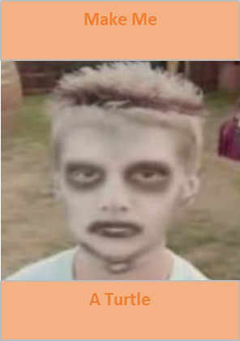
Excel Vocabulary Builder – Turtleify
Content Authority
Click Picture in Turtleify tab
File will be exported under the file name <VocabularyName>.ttl into a desktop folder named Vocabs

Slide 12
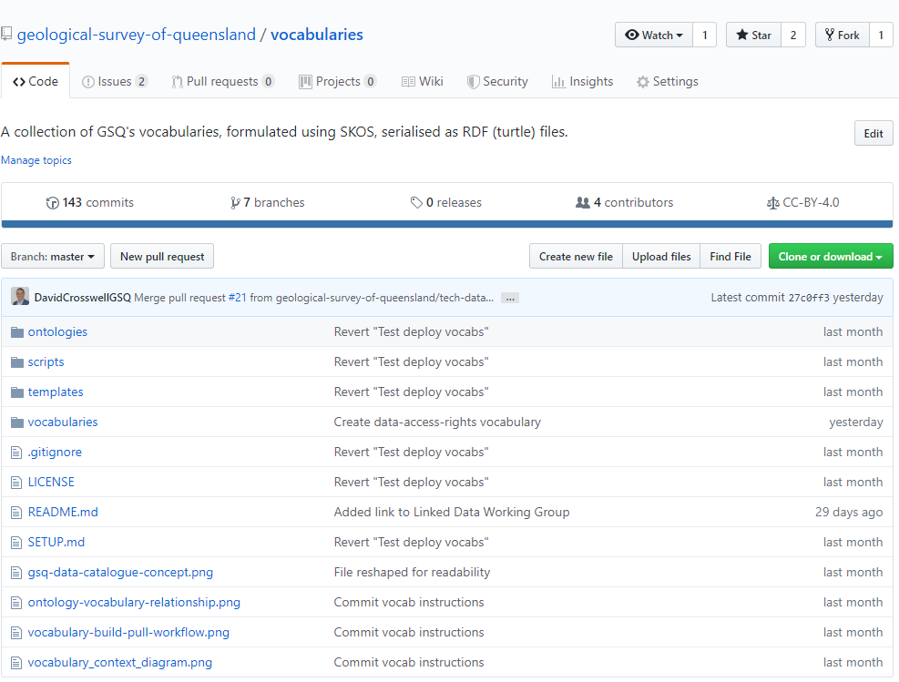
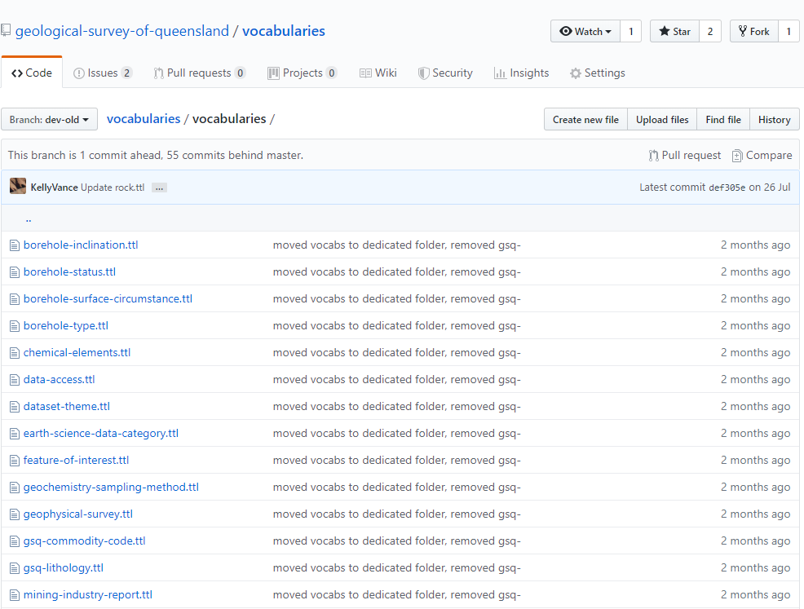
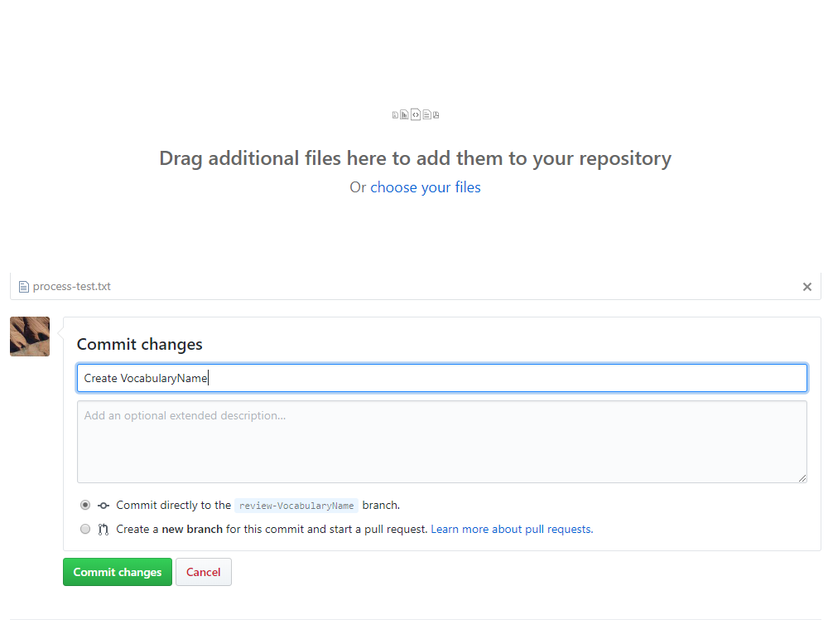
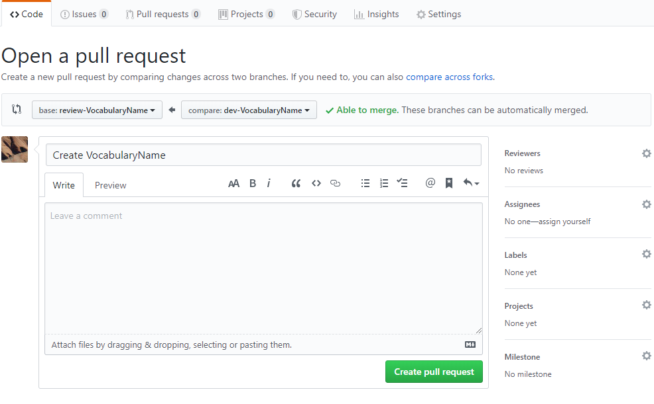
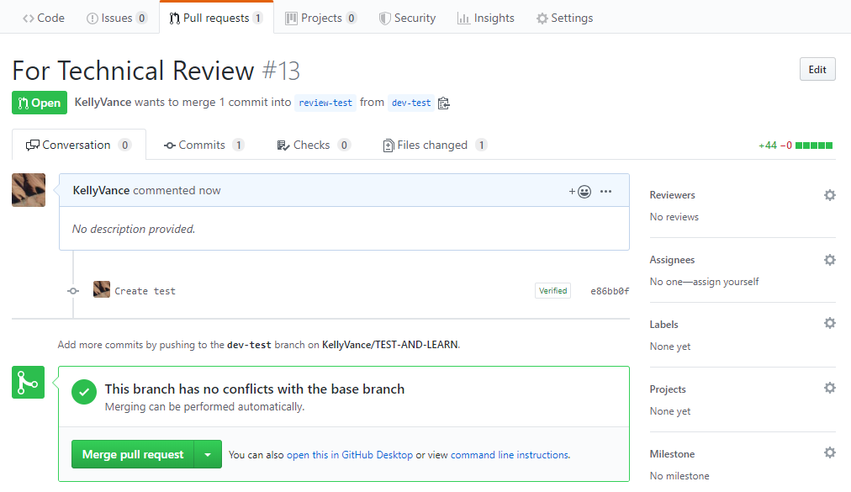
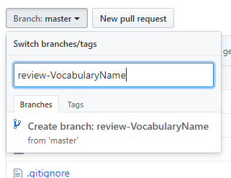
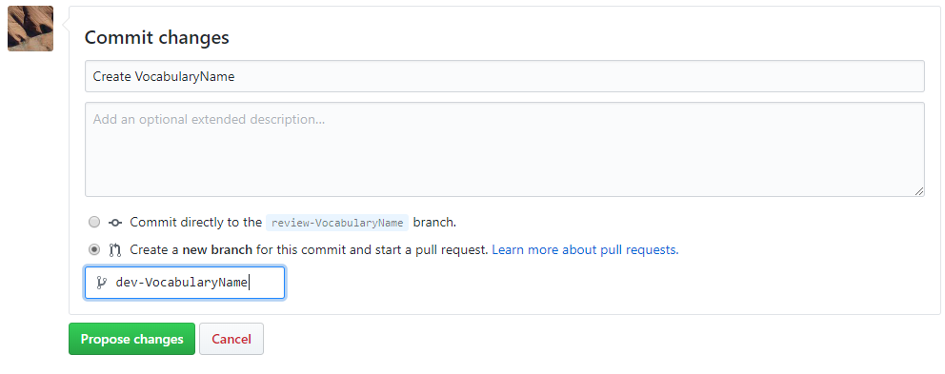
Submit Vocabulary
Content Authority
Navigate to the Vocabulary Repository of the GSQ Github page
Click [Branch:] button and enter review-<VocabularyName>, click [Create branch: from ‘master’]
Open the Vocabularies Folder within the repository
Import .ttl file intoGitHub by dragging and dropping the file onto the vocabulary list or using the “Upload files” button.
Title Commit Changes with Create/Update <VocabularyName> e.g. Create earth-science-data-category vocabulary
Add any relevant notes in ‘Add an optional extended description’
Select ‘Create a new branch for this commit and start a pull request.‘ and name to dev-<VocabularyName> e.g. dev-earth-science-data-category
Click [Propose changes] button
Ensure that pull request is for
[base: review-<VocabularyName> ⇦ compare:dev-<VocabularyName>]
Click reviewers cog in top right of screen and add relevant data manager.
Add Title “For technical review - VocabularyName”
Click [Create pull request] button.
Once notified of approval by reviewers, click [Merge pull request]

Slide 13
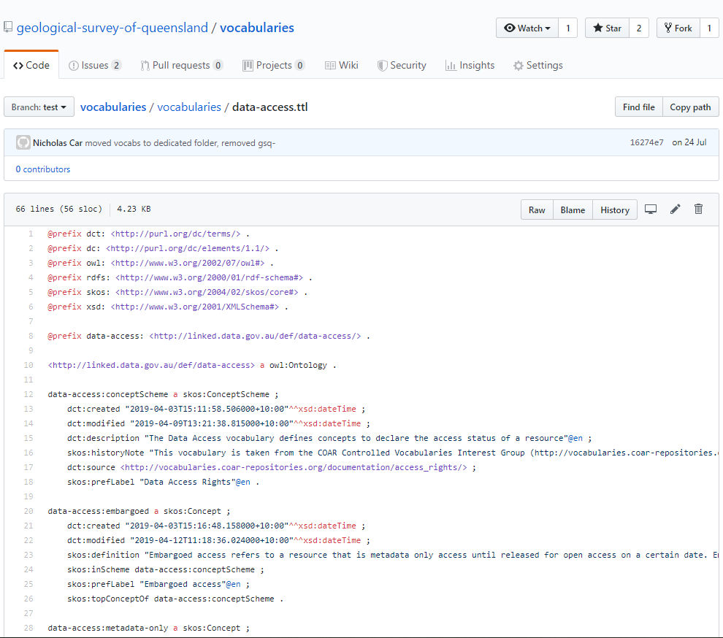
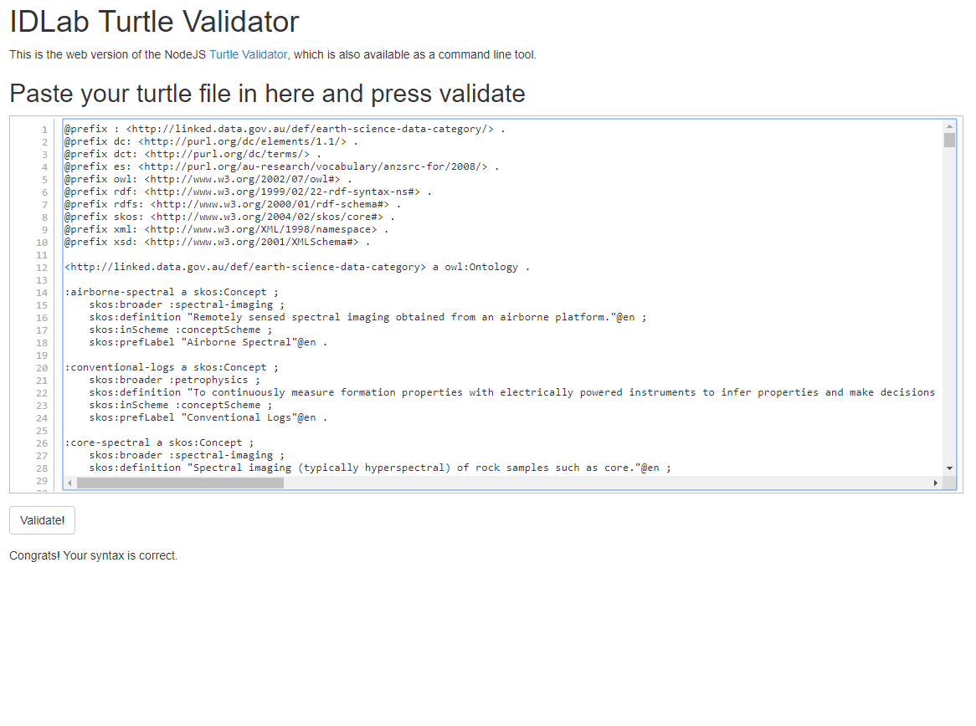
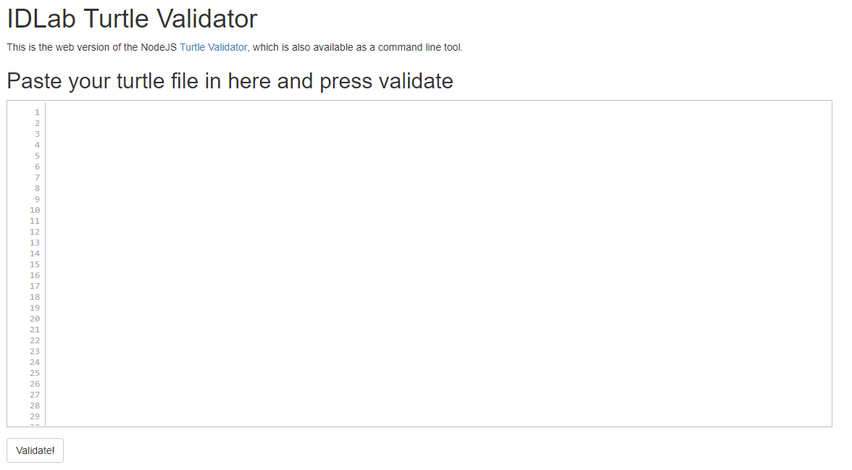
SKOS Optimisation - Validate
Data Manager
Open the relevant vocabulary in GitHub and click the ‘Raw’ button
Copy (ctrl+C) the contents of the Raw ttl page
In a new browser window open IDLab Turtle Validator
Paste (ctrl+V) the contents of the Raw ttl page into the IDLab Turtle Validator and click Validate.
File is valid if IDLab Turtle Validator gives the result “Congrats! Your syntax is correct.” If not seek further guidance.

Slide 14
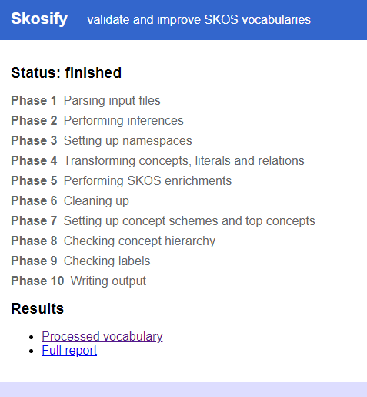
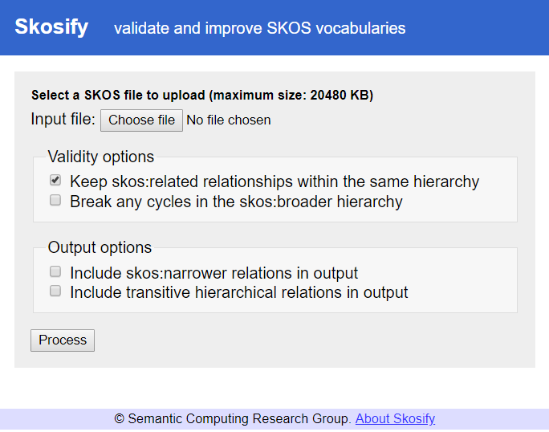
SKOS Optimisation - Format
Data Manager
In GitHub return to the main page for the vocabulary (as per picture on right), right-click the Raw button and ‘Save link as…’
Open Skosify in new window.
In Skosify tick the checkbox ‘Keep skos:related relationships within the same hierarchy’, all other boxes should be unticked.
Click ‘Choose file’ button, navigate to and select the file saved in Step 1
Click ‘Process’ button.
Check messages. Optimisations such as stripping whitespace is normal. Seek further guidance for unexpected errors.
Click ‘Processed vocabulary’, select all (ctrl+A) and copy (ctrl+C)
In Notepad open the vocabulary ttl file (from step 1), select all (ctrl+A) and paste (ctrl+V) the processed vocabulary to overwrite. Save file.

Slide 15
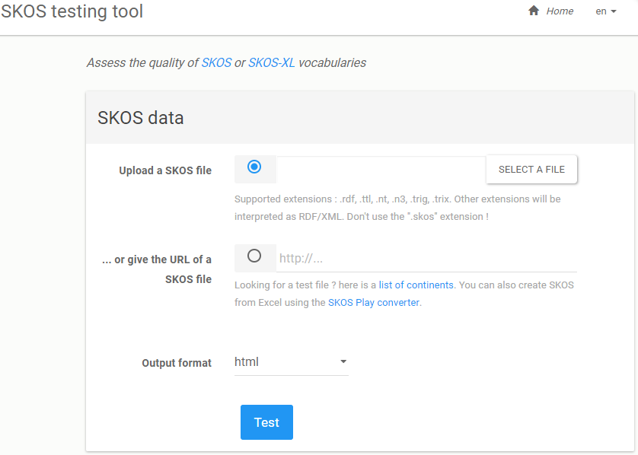
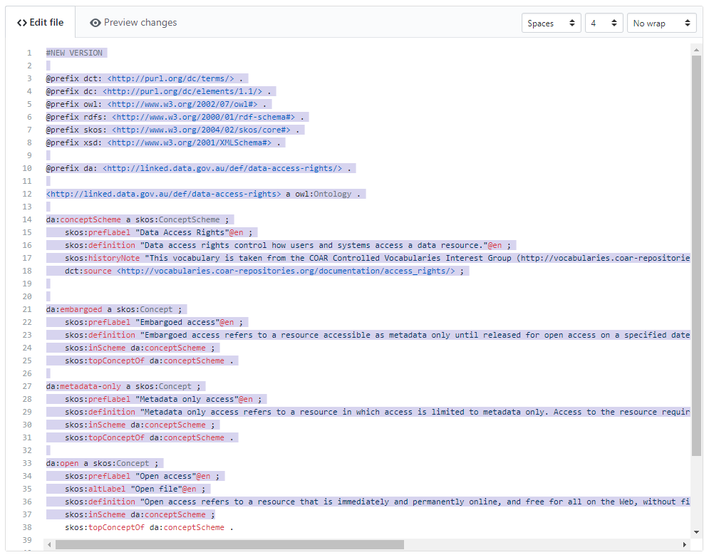
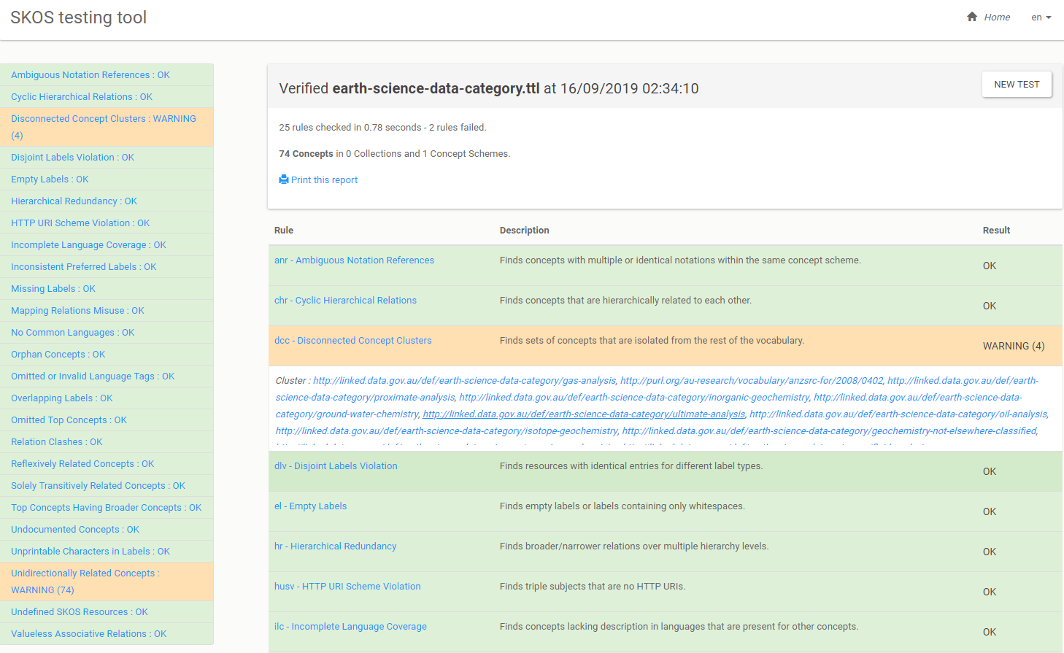
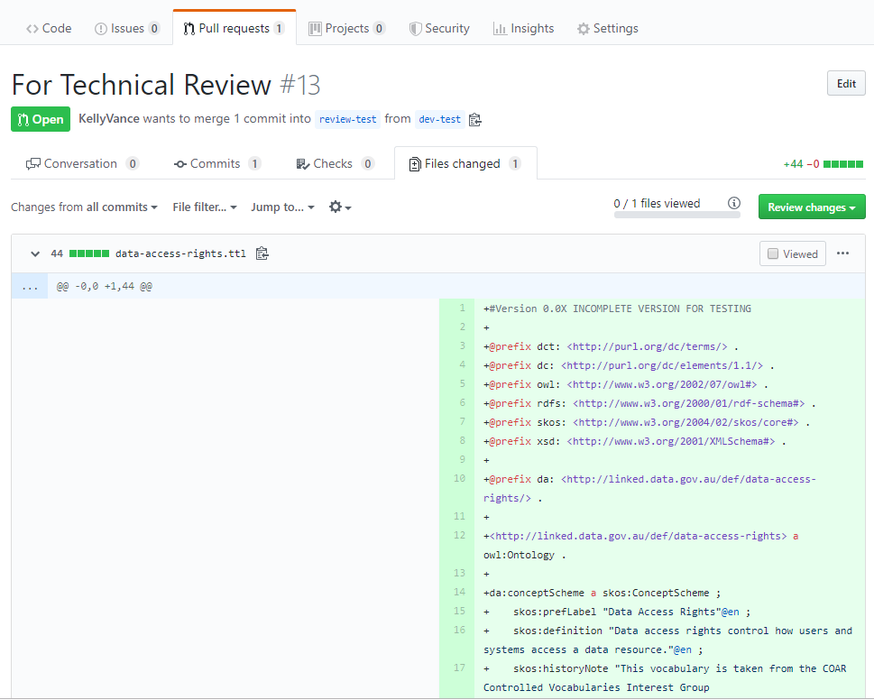
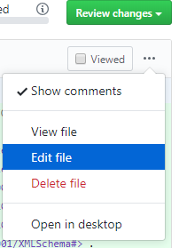
SKOS Optimisation - Check
Data Manager
In browser window open SKOS testing tool.
Click ‘SELECT A FILE’ button, navigate to and select the file saved in the SKOS Optimisation - Format page.
Click the ‘Test’ Button.
Check results page
Disconnected Concept Clusters : WARNING (X) – X should equal the number of top concepts in the concept scheme
Unidirectionally Related Concepts : WARNING – Expected warning as narrower relationships are automatically inferred as the inverse of broader relationships.
For other errors seek further guidance.
If file is valid open in notepad and copy contents (Ctrl+A then Ctrl+C)
Open pull request in GitHub
Click [Files changed]
Click […] and select [Edit file]
Overwrite with optimised contents from notepad (Ctrl+A then Ctrl+V) (Ctrl+A then Ctrl+C)
Scroll to bottom of page and title Commit changes to ’Optimisation Complete’, then commit directly to the dev-VocabularyName branch
Back to Top ↑

Slide 16
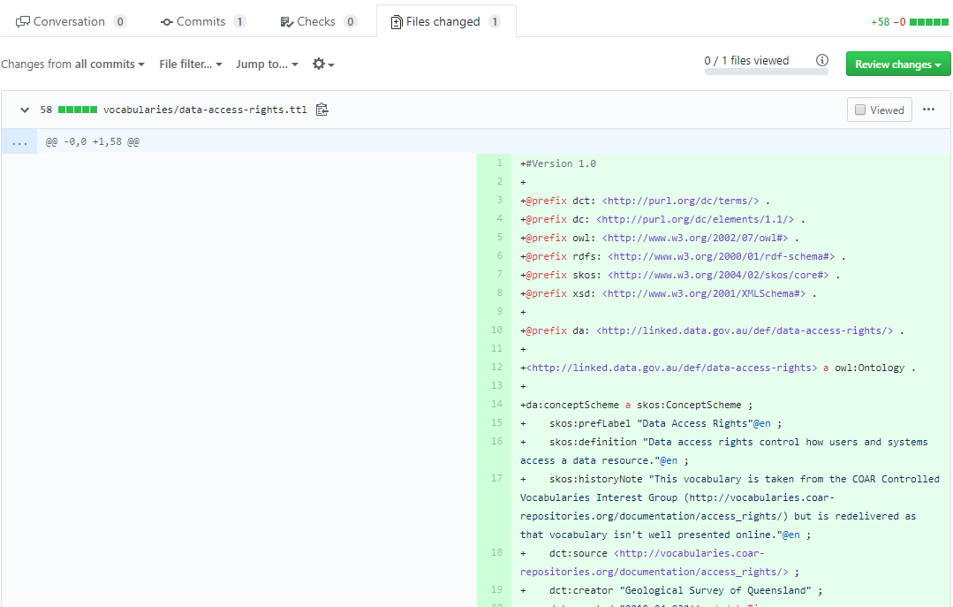
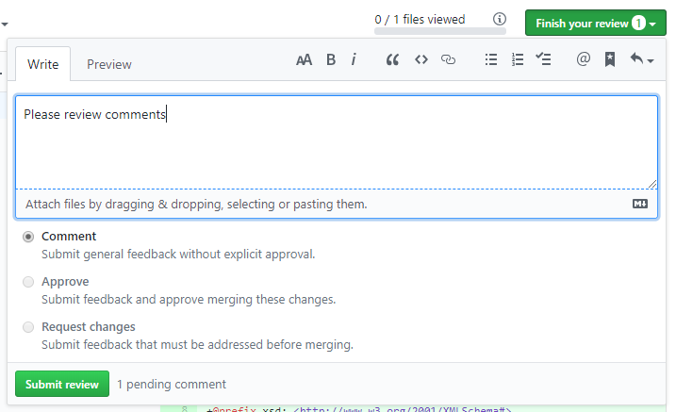
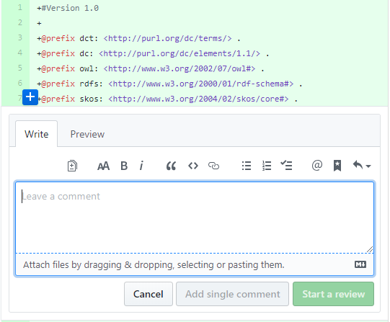
Technical Review
Data Manager
Navigate to vocabulary pull request
Click [Files changed]
Follow review steps on following pages and comment on any lines that need revision by moving mouse to + next to the line and clicking the blue box that appears to open the comment pop-up Add comments and click [Start a review]
Add further comments on other lines as needed
Click [Finish your review] and add any required summary notes. Click [Submit Review]
Back to Top ↑

Slide 17
Technical Review
Data Manager
For detailed instruction go to Vocabulary Wiki on GSQ Github
@prefix : <http://linked.data.gov.au/def/earth-science-data-category/> .
@prefix dc: <http://purl.org/dc/elements/1.1/> .
@prefix dct: <http://purl.org/dc/terms/> .
@prefix es: <http://purl.org/au-research/vocabulary/anzsrc-for/2008/> .
@prefix owl: <http://www.w3.org/2002/07/owl#> .
@prefix rdf: <http://www.w3.org/1999/02/22-rdf-syntax-ns#> .
@prefix rdfs: <http://www.w3.org/2000/01/rdf-schema#> .
@prefix skos: <http://www.w3.org/2004/02/skos/core#> .
@prefix xml: <http://www.w3.org/XML/1998/namespace> .
@prefix xsd: <http://www.w3.org/2001/XMLSchema#> .
<http://linked.data.gov.au/def/earth-science-data-category> a owl:Ontology .
:conceptScheme a skos:ConceptScheme ;
dct:created "2019-09-06T8:17:57+10:00"^^xsd:dateTime ;
dct:modified "2019-09-11T8:46:46+10:00"^^xsd:dateTime ;
dct:source "Modified from the Fields of Research vocabulary from the Australian and New Zealand Standard Research Classification (ANZSRC). Relevant earth science categories have been extracted and augmented with narrower terms relevant for industry and research institutions." ;
skos:definition "A classification that facilitates identification of the Fields of Research, or topics, to which a dataset, activity, or entity pertain."@en ;
dct:creator "Geological Survey of Queensland" ;
skos:prefLabel "Earth Science Data Category"@en .
:airborne-spectral a skos:Concept ;
skos:broader :spectral-imaging ;
skos:definition "Remotely sensed spectral imaging obtained from an airborne platform."@en ;
skos:inScheme :conceptScheme ;
skos:prefLabel "Airborne Spectral"@en .
:conventional-logs a skos:Concept ;
skos:broader :petrophysics ;
skos:definition "To continuously measure formation properties with electrically powered instruments to infer properties and make decisions about drilling and production operations. Source: Schlumberger Oilfield Glossary"@en ;
skos:inScheme :conceptScheme ;
skos:prefLabel "Conventional Logs"@en .
Verify that the vocabulary name:
Reflects the vocabulary content.
Uses only plain English words.
Starts with the prefix “GSQ” if the vocabulary is about GSQ-only concepts, e.g. GSQ Dataset Theme.
Does NOT start with the prefix “GSQ” if the vocabulary is about universal concepts, e.g. Earth Science Data Category.
Validate that the vocabulary URI
Is in the format:
<http://linked.data.gov.au/def/VocabularyID>
e.g. <http://linked.data.gov.au/def/gsq-dataset-theme>
The vocabulary ID within the URI is:
All lower case ASCII characters - letters and numbers only.
No spaces - use hyphens in place of spaces.
e.g. earth-science-data-category.
Does not have a trailing slash on the Ontology Line.
Validate the RDF prefix:
Is declared for the vocabulary and is in the format:
@prefix prefix: <vocab-URI/> .
e.g. @prefix gsqtheme: <http://linked.data.gov.au/def/gsq-dataset-theme/> .
Is letters only and as short as possible (max 8 characters).
Note: RDF Prefix may be a colon only
e.g. @prefix : <http://linked.data.gov.au/def/gsq-dataset-theme/> .
The prefix declaration must use the vocab URL with a trailing slash.
Validate the Concept Scheme
The vocabulary must include one and only one concept scheme.
Declaration: Must be on the first line of the concept scheme and be in the form prefix:conceptScheme a skos:ConceptScheme ;
e.g. gsqtheme:conceptScheme a skos:ConceptScheme ;
Vocabulary Title: Must be in the form skos:prefLabel “title”@en ;
e.g. skos:prefLabel “GSQ Dataset Theme”@en ;
Definition: Must be in the form skos:definition “definition”@en ;
e.g. skos:definition “This is the definition of the concept scheme”@en ;
Created: Must be the date the vocabulary was originally created and be in the form dct:created “yyyy-mm-dd”^^xsd:date ; or dct created yyyy-mm-ddThh:mm:ss^^xsd:dateTime ;
e.g. dct:created "2019-03-06"^^xsd:date ;
or dct:created "2019-03-06T09:15:30"^^xsd:dateTime ;
Modified: Must be the date the vocabulary was last modified and be in the same form as the created date.
Additional Properties: Additional properties may be present after the five lines. Allowed properties are:
skos:historyNote - describing the history of the vocabulary
dct:source - describing the source of the vocabulary
dct:creator - identifying the person that created the vocabulary

Slide 18
Technical Review
Data Manager
For detailed instruction go to Vocabulary Wiki on GSQ Github
@prefix : <http://linked.data.gov.au/def/earth-science-data-category/> .
@prefix dc: <http://purl.org/dc/elements/1.1/> .
@prefix dct: <http://purl.org/dc/terms/> .
@prefix es: <http://purl.org/au-research/vocabulary/anzsrc-for/2008/> .
@prefix owl: <http://www.w3.org/2002/07/owl#> .
@prefix rdf: <http://www.w3.org/1999/02/22-rdf-syntax-ns#> .
@prefix rdfs: <http://www.w3.org/2000/01/rdf-schema#> .
@prefix skos: <http://www.w3.org/2004/02/skos/core#> .
@prefix xml: <http://www.w3.org/XML/1998/namespace> .
@prefix xsd: <http://www.w3.org/2001/XMLSchema#> .
<http://linked.data.gov.au/def/earth-science-data-category> a owl:Ontology .
:conceptScheme a skos:ConceptScheme ;
dct:created "2019-09-06T8:17:57+10:00"^^xsd:dateTime ;
dct:modified "2019-09-11T8:46:46+10:00"^^xsd:dateTime ;
dct:source "Modified from the Fields of Research vocabulary from the Australian and New Zealand Standard Research Classification (ANZSRC). Relevant earth science categories have been extracted and augmented with narrower terms relevant for industry and research institutions." ;
skos:definition "A classification that facilitates identification of the Fields of Research, or topics, to which a dataset, activity, or entity pertain."@en ;
dct:creator "Geological Survey of Queensland" ;
skos:prefLabel "Earth Science Data Category"@en .
:airborne-spectral a skos:Concept ;
skos:broader :spectral-imaging ;
skos:definition "Remotely sensed spectral imaging obtained from an airborne platform."@en ;
skos:inScheme :conceptScheme ;
skos:prefLabel "Airborne Spectral"@en .
:conventional-logs a skos:Concept ;
skos:broader :petrophysics ;
skos:definition "To continuously measure formation properties with electrically powered instruments to infer properties and make decisions about drilling and production operations. Source: Schlumberger Oilfield Glossary"@en ;
skos:inScheme :conceptScheme ;
skos:prefLabel "Conventional Logs"@en .
Check Additional Properties:
Additional optional properties may be present. Allowed properties are:
Created: in the same form as the concept scheme
Modified: in the same form as the concept scheme
Labels: as per the following
Preferred Label – One per language in form skos:prefLabel “Name”@en ;
e.g. Skos:prefLabel “Thongs”@en ;
Alternate Labels – Where a concept has multiple, legitimate and common synonyms describe in the form skos:altLabel “Alternate name”@en ;
e.g. skos:altLabel “Flip flops”@en ;
Hidden Labels – Where the concept has synonyms that are colloquial, vernacular, or slang per describe in the form skos:hiddenLabel “Hidden name”@en ;
e.g. Skos:hiddenLabel “Jandals”@en ;
Additional Notes: as per the following
Example – Where the concept requires an illustrative example to clarify useage use skos:example “example”@en ;
History Note – When significant changes to the meaning of a concept are made use skos:historyNote “description of change”@en ;
Change Note - When fine-grained changes to a concept, for the purposes of administration and maintenance are made use skos:changeNote “description of change”@en ;
Notations – Where specific codes relate to concepts use skos:notation “NOTN” ;
Validate the Concepts:
The vocabulary must include at least two concepts.
Declaration: must be on the first line of each concept and be in the form prefix:conceptID a skos:Concept ;
e.g. gsqtheme:seismic-data a skos:Concept ;
Preferred Name: must be in sentence case (First word starts with a capital) and in the form skos:prefLabel “Concept name”@en ;
e.g. skos:prefLabel “GSQ dataset theme”@en ;
Definition: must be a plain English description of the concept and be in the form skos:definition “definition”@en ;
e.g. skos:definition “This is the definition of the concept”@en ;
In Scheme: must be in the form skos:inScheme prefix:conceptScheme
e.g. skos:inScheme gsqtheme:conceptScheme ;
Top Concept Of: Where a concept is a top level concept (i.e. the first division below the concept scheme) it must be described as atop concept in the form skos:topConceptOf prefix:conceptScheme
e.g. skos:topConceptOf gsqtheme:conceptScheme ;
Check Delimiters:
Each statement, concept or concept scheme must end in a fullstop.
All attributes within a concept or concept scheme must be separated by a semi-colon
Back to Top ↑

Slide 19
Technical Review
Data Manager
SKOS Integrity Conditions
The SKOS Reference document includes integrity conditions. Integrity conditions are statements that help determine whether or not given data (for example, a vocabulary) are consistent with respect to the SKOS data model.
What is "disjoint"?
Disjoint is a mathematical concept.
Two sets are said to be disjoint sets if they have no element in common.
Disjoint sets are said to be non-overlapping or non-intersecting.
Disjoint sets are also said to be mutually exclusive or independent.
1. skos:ConceptScheme is disjoint with skos:Concept
This condition states that SKOS concept schemes, or groups of SKOS concepts, must not be on the same hierarchical level as SKOS concepts and vice versa. See https://www.w3.org/TR/skos-reference/#L1228
e.g., in a veggie vocab, Vegetables is a skos:ConceptScheme. ThereforeVegetables must not also be a skos:Concept, and one of the concepts, like Lima Bean, may not be a skos:ConceptScheme.
2. skos:prefLabel, skos:altLabel and skos:hiddenLabel are pairwise disjoint properties
This condition states that no SKOS concept may be a member of more than one preferred label, alternate label, and hidden label. See https://www.w3.org/TR/skos-reference/#L1567
3. A resource has no more than one value of skos:prefLabel per language tag
This condition states that no SKOS concept may have more than one preferred label for each language tag. See https://www.w3.org/TR/skos-reference/#L1567
For example, the concept summer_squash has the preferred label of “Summer Squash” in English and of “Cucurbita pepo” in Latin, and there may not be any other preferred labels in English or Latin.
4. skos:related is disjoint with the property skos:broaderTransitive
This condition states that no two SKOS concepts may be connected by both related and broader transitive relationships. See https://www.w3.org/TR/skos-reference/#L2422
5. skos:Collection is disjoint with each of skos:Concept and skos:ConceptScheme
This condition states that SKOS collections, or labeled or ordered groups of SKOS concepts, must not be on the same hierarchical level as SKOS concepts and vice versa. For example, in the veggie vocab, Vegetables is a skos:Collection. This means that Vegetables must not also be a skos:Concept and one of the concepts, like Lima Bean, may not be a skos:Collection.
6. skos:exactMatch is disjoint with each of the properties skos:broadMatch and skos:relatedMatch
This condition states that no two SKOS concepts may be related by more than one of exact match, broader match, and related match. See https://www.w3.org/TR/skos-reference/#L5429
Back to Top ↑

Slide 20
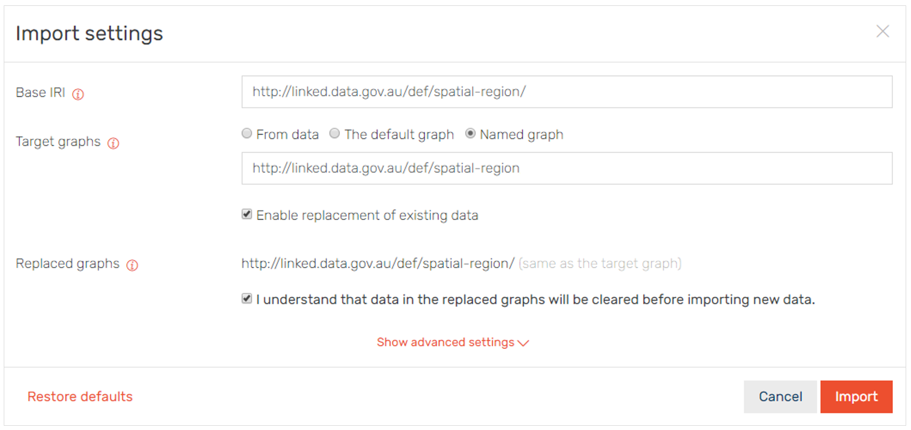
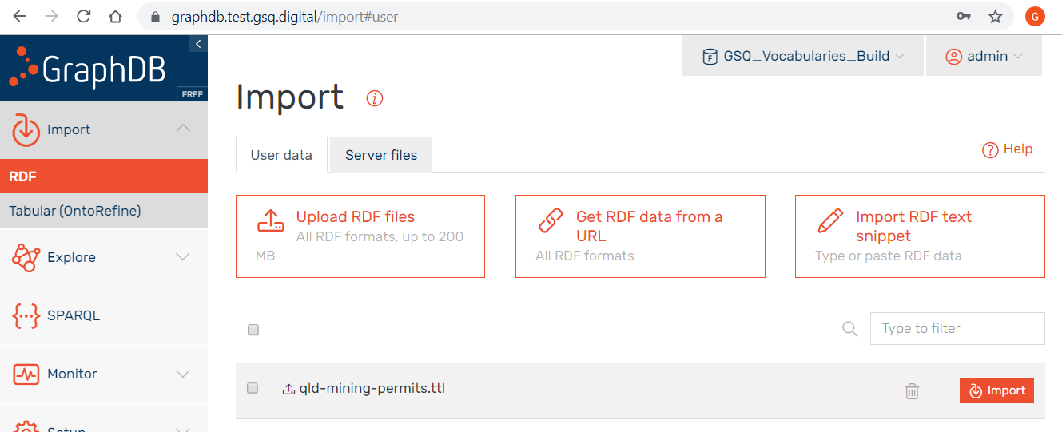
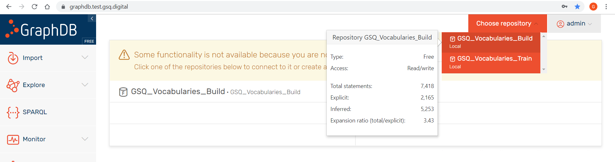
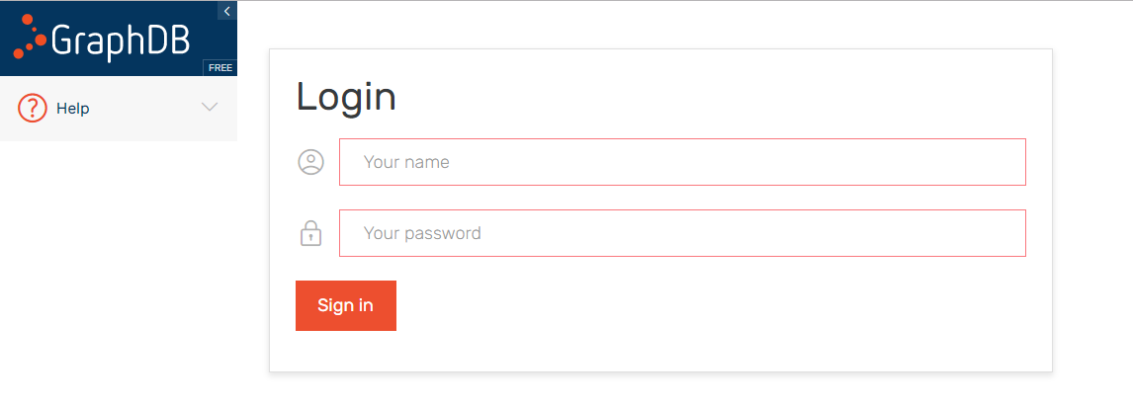
Publish to VocPrez Test
Data Manager
In GitHub return to the main page for the vocabulary (as per picture on right), right-click the Raw button and ‘Save link as…’
Log into GraphDB Test
Select GraphDB repository GSQ_Vocabularies_Build
Click [Import] and Select [RDF]
Click [Upload RDF files]
Navigate to and select TTL file from Step 1
Click [Import] for newly loaded file
Enter BASE IRI - the URI for the vocabulary. Use a trailing slash.
Select [Named Graph]
In Named Graph field enter URI for the vocabulary. Do NOT use a trailing slash.
Tick checkboxes:
Enable replacement of existing data
I understand that data in the replaced graphs will be cleared before importing new data
Click [Import]
Back to Top ↑

Slide 21
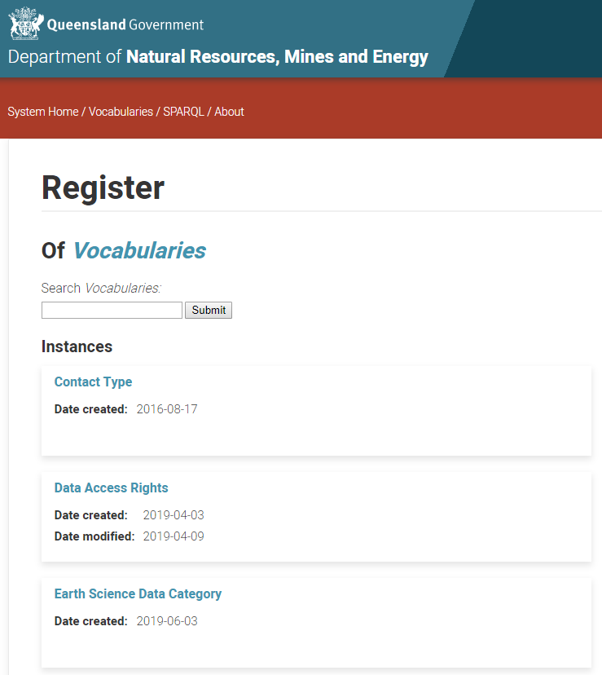
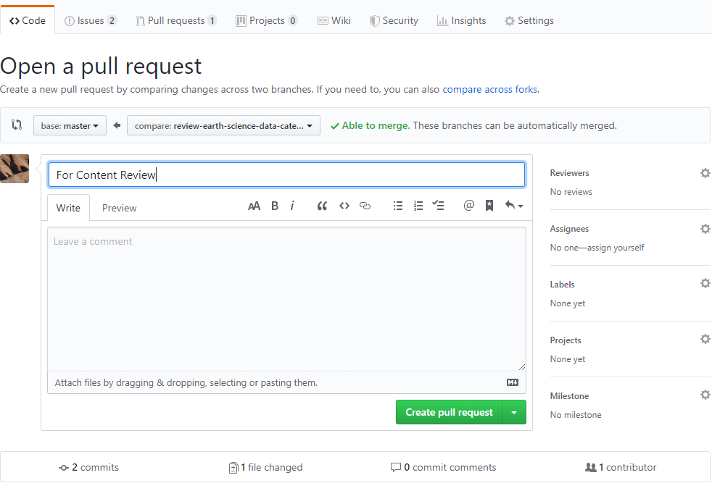
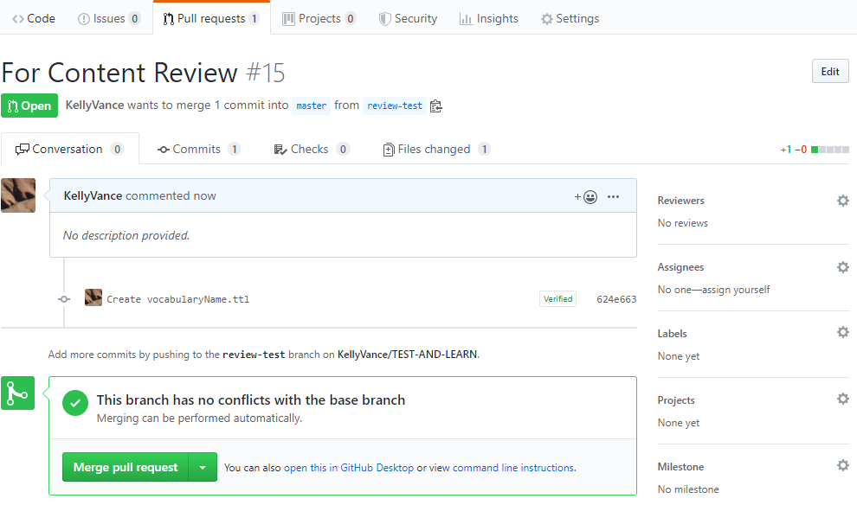

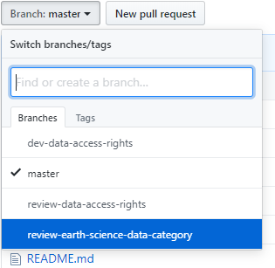
Request Content and Business Review
Data Manager
Ensure vocabulary is published to the VocPrez Test environment
Open the Vocabularies Folder within the vocabulary repository
Switch to review branch for vocabulary e.g. Branch: review-earth-science-data-category
Click [New Pull request]
Ensure that pull request is for
[base: master ⇦ compare: review-<VocabularyName>]
Click reviewers cog in top right of screen and add:
A minimum of at least one relevant peer reviewer
The vocabulary custodian
Click assignees cog in top right of screen and add:
The original content authority
Add Title “For content review – VocabularyName”
Add comment with link to vocabulary in VocPrez and identifying responsible peer reviewer(s), and custodian
e.g. https://vocabs.test.gsq.digital/vocabulary/HRM
Custodian – John Smith
Peer Reviewer 1 – Jane Smith
Peer Reviewer 2 – Elizabeth II HRM
Click [Create pull request] button.
Once notified of approval by reviewers, click [Merge pull request]
Back to Top ↑

Slide 22
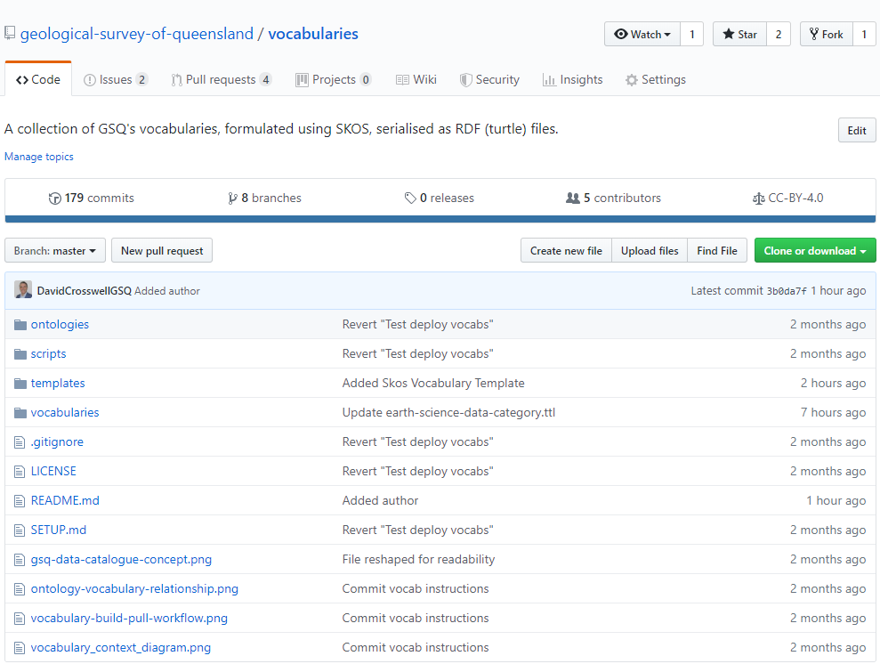
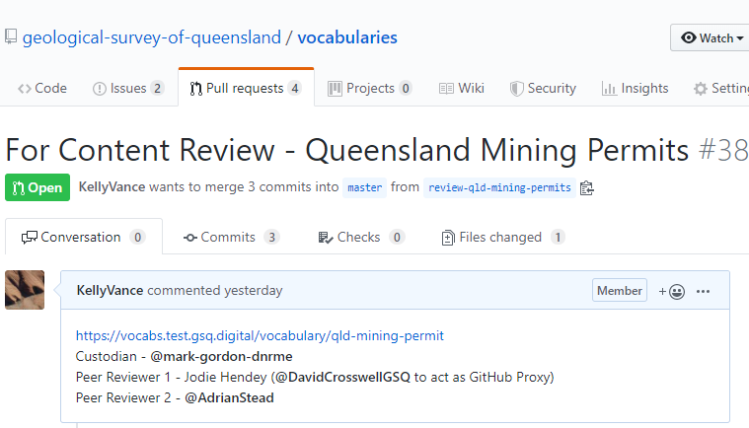
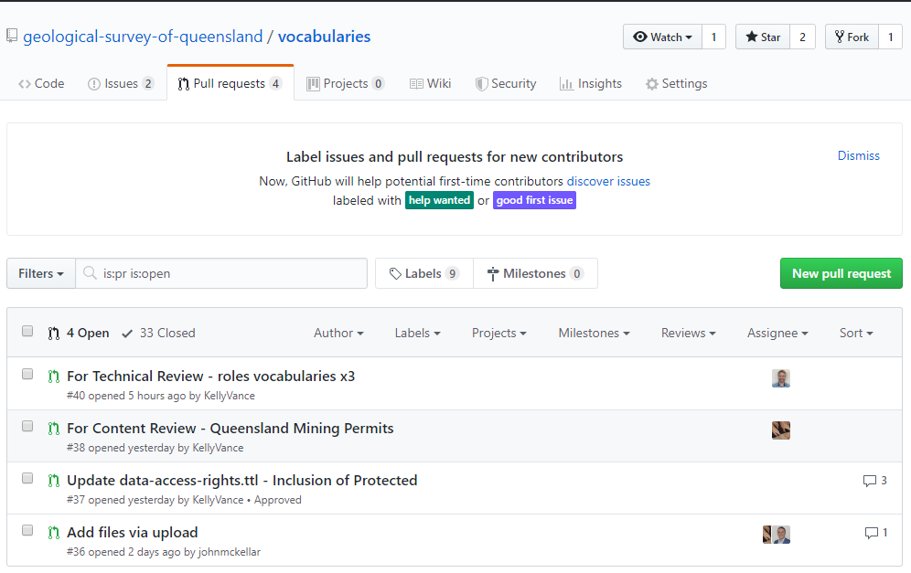
Content Review
Peer Reviewer
Navigate to pull requests in vocabularies repository
Open the applicable request
Open link to VocPrez TEST embedded in pull request in new window
On Github pull request page click [Files changed]
Comment on any lines that need revision by moving mouse to + next to the line and clicking the blue box that appears to open the comment pop-up Add comments and click [Start a review]
Add further comments on other lines as needed
Click [Finish your review] and add any required summary notes. Click [Submit Review]
For peer review, is the vocabulary
Broad enough to cover the intended content
To a sufficient level of detail. NB: Further detail may be added at a later stage through a new review process, or be included in a separate vocabulary for a specific sub-topic.
A complete representation of the subject without missing concepts (for practical purposes)
Free from conflicting concepts
Accurate in representing hierarchies. NB: Each concept may have multiple parent concepts e.g. Micrite may have both mudstone and carbonate rock parent concepts
Free of spelling, grammatical, and typographic errors.
Back to Top ↑

Slide 23
Business Review
Custodian
Navigate to pull requests in vocabularies repository
Open the applicable request
Open link to VocPrez TEST embedded in pull request in new window
On Github pull request page click [Files changed]
Comment on any lines that need revision by moving mouse to + next to the line and clicking the blue box that appears to open the comment pop-up Add comments and click [Start a review]
Add further comments on other lines as needed
Click [Finish your review] and add any required summary notes. Click [Submit Review]
For business review, is the vocabulary
Required as a business need
Fit for purpose i.e. meets the business need
Named and described in plain English, sufficient to clearly define its purpose
Free of spelling, grammatical, and typographic errors
Back to Top ↑

